Slide 1

IE 212: Computational Methods for Industrial Engineering
Lecture Notes #1:
Course Overview
&
Introduction
Dr. J. David Porter
Winter 2013

Slide 2
Today’s Agenda
Information on syllabus
  Instructor’s and graders’ information
  Office hours
  Textbook and textbook references
  Grading
    Homework, portfolios and examinations
  Class format
Homework #1
  Student information sheet
Introductory lecture

Slide 3
Course Overview

Slide 4
Instructor’s Information
Instructor: Dr. J. David Porter
Office: 420 Rogers Hall
Phone: (541) 737-2446
Email: david.porter@oregonstate.edu
Office Hours
  Mondays & Wednesdays 4:00 – 5:30 PM
  By appointment
Do not email homework technical questions
  Lengthy or potentially difficult questions should be handled face to face with instructor or GTA

Slide 5
Graduate Teaching Assistant
Leticia Cavazos
  Email: cavazosm@onid.orst.edu
  Office: 349 Batcheller Hall
  Office hours:
    Friday 2 – 3:30pm in BAT 349
  Responsibilities
    Answer questions about lecture material and homework assignments
    Support class administration

Slide 6
Undergraduate Teaching Assistants
Matthew Baker
  Email: bakematt@onid.orst.edu
Nathan Okorley
  Email: okorleyn@onid.orst.edu
Nick Rukke
  Email: rukken@onid.orst.edu
Seth Wiberg
  Email: wibergs@onid.orst.edu
Responsibilities
  Grade homework assignments
  Answer questions about homework

Slide 7
Pre-requisites
ENGR 112 and algebra
  Different backgrounds
Calculus
Differentiation and integration

Slide 8
Course Information
Course homepage:
  http://classes.engr.oregonstate.edu/mime/winter2013/ie212/
  Syllabus
  Handouts
  Lecture material
Homework assignments
Check the page on a regular basis for course information and announcements

Slide 9
Textbook and Textbook References
No “official” textbook
  However, you can access several electronic textbook references
All book references listed below are available free of charge in electronic format through the OSU library:
  Bovey, R., Bullen, S., Green, J. Excel 2007 VBA Programmer's Reference.
  Syrstad, T., Jelen, B. VBA and macros for Microsoft Excel 2007.
  Walkenbach, J. Excel 2007 Power Programming with VBA.

Slide 10
Grading Components
Homework
  Several homework assignments will be given
  Late assignments will NOT be allowed
Submitting homework assignments
  The majority of homework assignments will be completed and submitted electronically
    However, a few homework assignments will be submitted as a hard-copy at the beginning of the term
    MAKE SURE TO CAREFULLY REVIEW AND FOLLOW THE SUBMISSION REQUIREMENTS FOR EACH ASSIGNMENT
  If required in electronic format, completed homework assignments must be submitted via T.E.A.C.H. on the date/time they are due
    http://engr.oregonstate.edu/teach

Slide 11
Grading Components (cont.)
Portfolios
  Two homework portfolios will be submitted
  Portfolios will be composed of homework assignments corrected by the students based on the grader’s feedback
    Certain assignments cannot be made up as part of the portfolios
      Assignments not turned in by deadline
      Assignments given a zero due to academic dishonesty
    Due dates for portfolios will be communicated as the term progresses
Exams
  Closed-book and closed-notes
  Based on homework, lecture material, reading material

Slide 12
Grading Criteria
Homework 25%
Portfolio #1 10%
Portfolio #2 10%
Midterm Exam 15%
  Thursday, February 7th, 2013
Final Exam (cumulative) 15%
  Thursday, March 21st, 2013 @ 2:00pm
Final project (individual) 25%

Slide 13
Lecture Format
The first part of class will be devoted to questions
Unreasonably long questions will be handled one-on-one
If I do not know the answer, I will get it for the class by the next lecture
Lecture
  Ask questions
5 min. break
  Not meant as an exit time
End of Class
  Will try to leave time for questions

Slide 14
Lecture Format (cont.)
Material will be delivered on PowerPoint slides using a Tablet PC
  Material may be added to slides during class
  Examples will be completed electronically using Microsoft (MS) Excel and MS Visio
  There will be regular in-class problem solving sessions
Minor changes to the slides may be made just before class
All added (hand written) material is your responsibility
  Hand written material added by instructor will NOT be available on the website

Slide 15
Classroom Rules
Turn off cell phones and other communication devices
No web surfing
No newspapers
No completing homework or other assignments
No sleeping
Use common sense and be considerate of others
Notify instructor when absent from class as soon as possible
  Before or after the fact
  Justifiable reason

Slide 16
Homework #1: Information Sheet
Due on Thursday, Jan. 10th, 2013
  Information must be typed electronically
  Paper sheet must be turned in at the start of next lecture session
It helps me get your names right

Slide 17
Tentative Topics to Cover
Course Overview & Introduction
  Algorithm representation tools
Introduction to VBA
  Visual Basic Environment
Coding in VBA
  Manipulating Excel Objects (i.e., Properties, and Methods)
  Variables
  Programming structures
  Array manipulation
  Developing sub procedures and function procedures
Designing user interfaces

Slide 18
Instructor Expectations
Students will attend class regularly
  Twice a week for 10 weeks
Students will bring their laptops to class
  Will follow along during in-class exercises to develop/improve their programming skills
Students will not use their laptops for
  WWW browsing
  Facebook look up/updating
  Other activities not related to this class

Slide 19
Software Resources
If your laptop does not have MS Excel and/or MS Visio
  You can purchase MS Office from the OSU bookstore
    PC users → $100
    MAC users → $70-$100
  You can connect to a couple of servers via a Remote Desktop Connection
    Server option #1: windows.engr.oregonstate.edu
    Server option #2: term-linux.engr.oregonstate.edu
  In the Username field, write “ENGINEERING\yourENGRusername”
    Then type your ENGR password

Slide 20
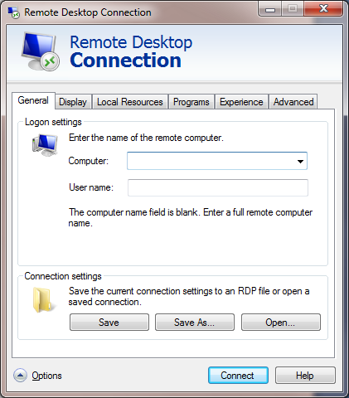
Software Resources (cont.)
Remote desktop connection client (Windows)
  Start\All Programs\Accessories
A couple of options:
windows.engr.oregonstate.edu
term-linux.engr.oregonstate.edu
ENGINEERING\yourUserName

Slide 21
Questions?

Slide 22
Introduction

Slide 23
Introduction to Computer Programming
Computer programs are written to solve problems or perform tasks on a computer
  A computer program is also referred to as a project, application, or solution
Programmers translate the solutions or tasks into language that a computer can understand
Computers will only do what we instruct them to do
  Therefore, we must be very careful and thorough with our instructions

Slide 24
Performing a Task on the Computer
The first step in writing instructions to carry out a task is to determine what the output should be
  Exactly what the task should produce
The second step is to identify the input data
  Data necessary to obtain the output
The last step is to determine how to process the input to obtain the desired output
  For example, determine what formulas or ways of doing things can be used to obtain the desired output

Slide 25
Performing a Task on the Computer (cont.)
Example
  Assume that after interviewing your customer, she would like you to write a computer program to determine how fast a car is traveling
Input
Processing
Output

Slide 26
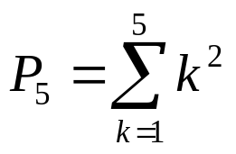
Performing a Task on the Computer (cont.)
In-Class Exercise
  Assume that after interviewing your customer, she would like you to write a computer program to:
Task | Output | Input | Processing
Calculate the sum of two integer numbers
Compute the sum of squares of the first 5 positive integer numbers >0

Slide 27
Program Planning
As seen in the prior examples, the output typically determines the input and the processing when we solve a problem
  Think of this process as a cooking recipe
    How would the food taste if you tried to cook it without a plan?
Many programmers (especially students in their first programming course) try to write programs without first developing a careful plan
  The more complicated the problem, the more complete the plan must be
  You will spend much less time working on a program if you devise a carefully thought out step-by-step plan
  Simple plans can even be tested before you write the actual program

Slide 28
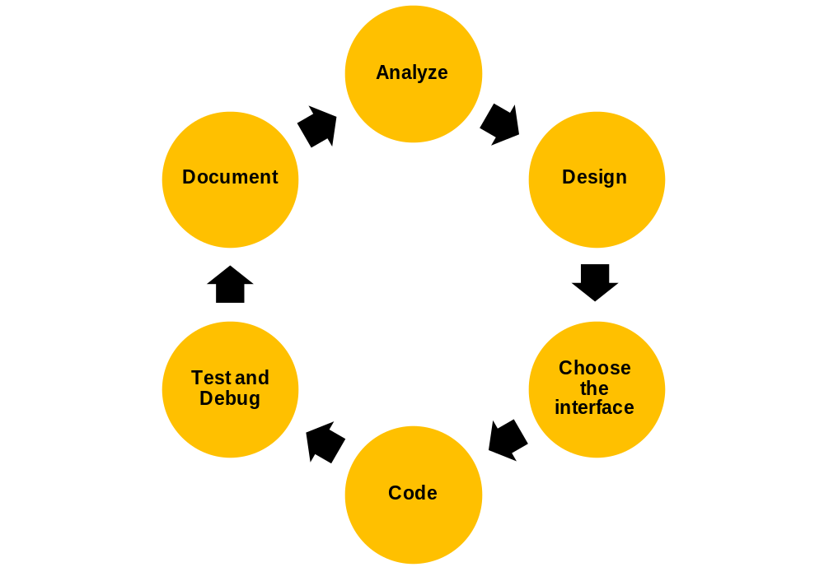
Program Development Cycle
Many programmers plan their programs using a sequence of steps referred to as the program development cycle

Slide 29
Program Development Cycle
Detailed steps of the program development cycle
  Analyze
    Define the problem (what the output should be)
    Have a clear idea of what data (or input) are given and the relationship between the input and the desired output
  Design
    Plan the solution to the problem
    Find a logical sequence of precise steps that solve the problem
      Typically requires developing a flowchart, pseudocode or a hierarchical chart
    Use representative data to test the algorithm by hand to ensure that it is correct
  Choose the interface
    Determine how the input will be obtained (e.g., user provided, input file, etc.) and how the output will be displayed (e.g., text box)
    Create appropriate controls to allow the user to control the program

Slide 30
Program Development Cycle (cont.)
  Code
    Translate the algorithm into a programming language and enter it into the computer
  Test and debug
    Locate and remove any errors in the program
    Testing is the process of finding the errors in the program and debugging is the process of removing the errors from the program
  Complete the documentation
    Organize all the material that describes the program
    Documentation is intended to allow another person, or the programmer at a later date, to understand the program
    Also includes comments added by the programmer directly into the code

Slide 31
Algorithm Representation Tools
You use algorithms everyday to make decisions and perform tasks
  For instance, whenever you mail a letter, you must decide how much postage to put on the envelope
  A rule of thumb is to use one stamp for every five sheets of paper (or fraction thereof)
How would the algorithm for this problem look like?

Slide 32
Algorithm Representation Tools (cont.)
We need a structured procedure to represent the sequence of activities, steps, and decision points that occur in an algorithm
The three most popular algorithm representations tools are:
  Flowcharts
    Graphically depict the logical steps to carry out a task and show how the steps relate to each other
  Pseudocode
    Uses English-like phrases to outline the task
  Hierarchy charts
    Show how the different parts of a program relate to each other

Slide 33
Flowcharts
Consist of special geometric symbols connected by arrows
  The shape of the symbol indicates the type of operation that is to occur
  Within each symbol is a phrase presenting the activity at that step
The arrows connecting the symbols (called flowlines), show the progression in which the steps take place
Flowcharts should “flow” from the top of the page to the bottom
Although the symbols used in flowcharts are standardized, no standards exist for the amount of detail required within each symbol

Slide 34
Flowcharts Symbols
Symbol | Name | Meaning
 | Flowline | Used to connect symbols and indicate the flow of logic.
 | Terminal | Used to represent the beginning (Start) or the end (End) of a task.
 | Input/Output | Used for operations such as reading or displaying. The data to be read or displayed are described inside.
 | Processing | Used for arithmetic and data-manipulation operations. The instructions are listed inside the symbol.

Slide 35
Flowcharts Symbols (cont.)
Symbol | Name | Meaning
 | Decision | Used for any logic or comparison operation. Has one entry and two exit paths. Exit paths are “Yes” and “No” decisions.
 | Connector | Used to join different flowlines.
 | Offpage Connector | Used to indicate that the flowchart continues to a second page.
 | Annotation | Used to provide additional information about another flowchart symbol.

Slide 36
Flowchart Basic Structures
In the mid-1960s, mathematicians proved that any program, no matter how complicated, can be constructed using one or more of only three structures
A structure is a basic unit of programming logic

Slide 37
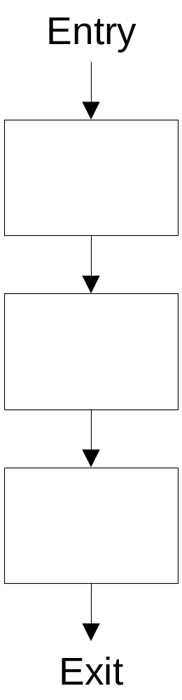
Flowchart Basic Structures (cont.)
Sequence

Slide 38
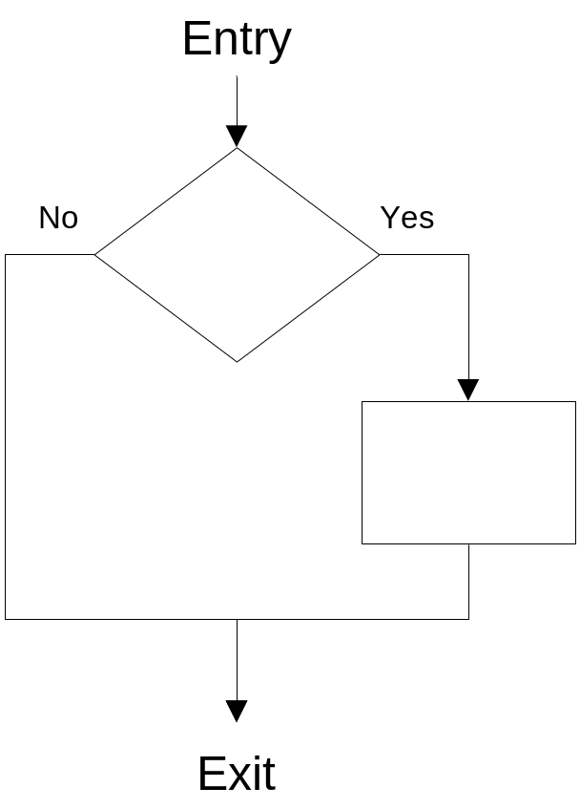
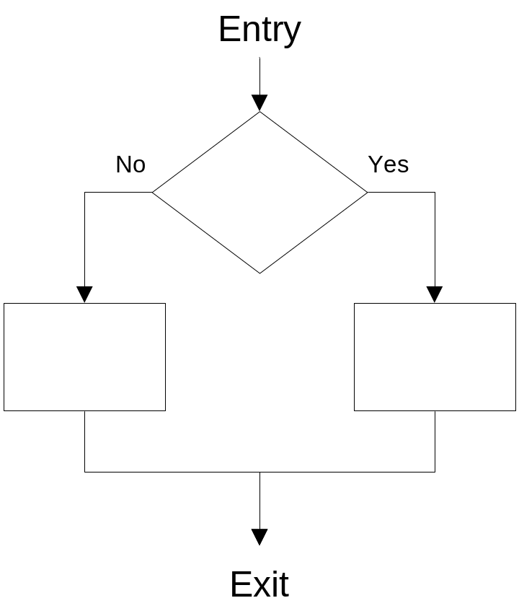
Flowchart Basic Structures (cont.)
Selection
Single
Double

Slide 39
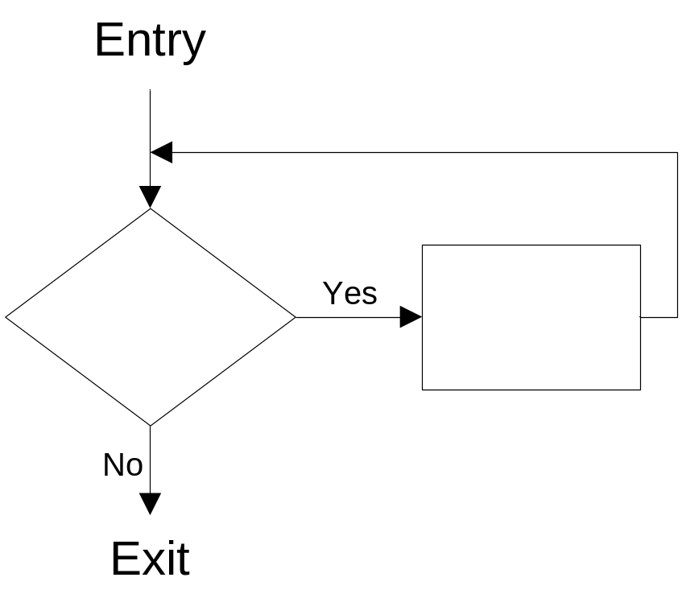
Flowchart Basic Structures (cont).
Repetition (loop)

Slide 40
Flowchart Basic Structures (cont.)
A structured program has the following characteristics:
  A structured program includes only combinations of the three basic structures shown before
    Any structured program might contain one, two, or all three types of structures
  Each of the structures has a single entry point and a single exit point
  Structures can be stacked or connected to one another only at their entry or exit points
  Any structure can be nested within another structure

Slide 41
Flowchart Example
Flowchart for the postage stamp problem

Slide 42
Design Mistakes with Flowcharts
The most common design mistakes made when developing a flowchart are the following:
  No clear beginning or end of the flowchart
    Sometimes symbols are completely missing
  Not indicating clearly that the flowchart takes more than one page
  Using the wrong symbol to represent a task
    e.g., using a processing symbol to represent a decision
  The direction of the logic flow is not clear
  Missing “Yes” or “No” labels on decision symbol
  Flow lines crossing
    This should be avoided unless absolutely necessary

Slide 43
Pseudocode
Pseudocode is an abbreviated version of actual computer code (hence, pseudocode)
Pseudocode allows the programmer to focus on the steps required to solve the problem rather than on how to use the computer language
When the pseudocode is completed, it can be easily translated into any programming language (e.g., Basic, C, Fortran, etc.)
Advantages
  It is compact and probably will not extend for many pages
  The plan looks like the code to be written
  Thus, this is the tool preferred by many programmers

Slide 44
Pseudocode Example
Pseudocode for the postage stamp problem
  Program: Determine the proper number of stamps for a letter
  Determine number of sheets
  Set the number of stamps to sheets divided by 5
  Round the number of stamps up to the next whole number
  Report stamps

Slide 45
Design Mistakes with Pseudocode
The most common design mistakes made when developing pseudocode are the following:
  Pseudocode is written following a specific programming language syntax
    As opposed to programming language neutral
  Pseudocode is written almost as executable code as opposed to high-level instructions

Slide 46
Hierarchy Chart
A hierarchy chart shows the overall program structure but omits the specific processing logic
  It describes what each part (or module) of the program does and also shows how each module relates to each other
  The details of how the modules work, however, are omitted
Hierarchy charts are read top to bottom and left to right
  Each module can be subdivided into submodules that branch out under it
The main benefit of hierarchy charts is in the initial planning of the program
  Each module can then be refined into more detailed plans using flowcharts or pseudocode

Slide 47
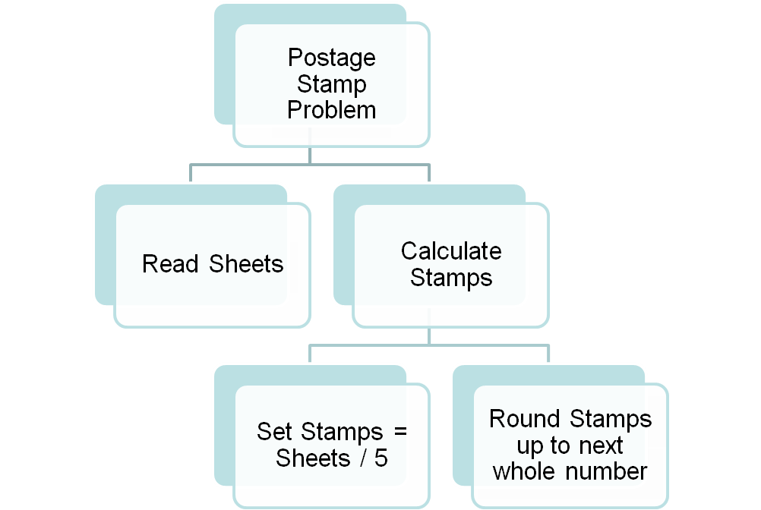
Hierarchy Chart Example
Hierarchy chart for the postage stamp problem

Slide 48
Design Mistakes with Hierarchy Charts
The most common design mistakes made when developing a hierarchy chart are the following:
  Not clearly identifying the main tasks per level of the hierarchy
  Too many details in the modules

Slide 49
In Class Exercise
Develop an algorithm to report the average grade for an exam taken by a class
Represent your algorithm using
  Flowchart
  Pseudocode
  Hierarchy chart

Slide 50
In Class Exercise – Flowchart

Slide 51
In Class Exercise – Pseudocode

Slide 52
In Class Exercise – Hierarchy Chart

Slide 53
Introduction to DSS
A decision support system (DSS) is an intelligent information system which can run sophisticated models at the back-end, but is friendly enough at the front-end to be used comfortably by any user
A DSS gives its users access to a variety of data sources, modeling techniques, and stored domain knowledge via an easy to use graphical user interface (GUI)
For example, a DSS can:
  Use the data residing in spreadsheets or databases
  Prepare mathematical models using this data
  Solve or analyze these models using problem-specific methodologies
  Assist the user in the decision-making process through a graphical user interface

Slide 54
Defining a DSS
A DSS is a model-based or knowledge-based system intended to support managerial decision making in semi-structured or unstructured situations (Turban and Aronson, 2001)
A DSS is not meant to replace a decision maker
  Its objective is to extend his/her decision making capabilities
Characteristics of a DSS include:
  Combining human judgment with computerized information
  Designed to be user-friendly
  Uses models for analyzing decision-making situations
  Improves the effectiveness of making a decision
  Provides managerial support

Slide 55
Defining a DSS (cont.)
A DSS application contains five components:
  Database
  Knowledge base
  Model base
  Graphical user interface (GUI)
  User
Decision Support System
Database
Model Base
Knowledge Base
GUI
User

Slide 56
Components of a DSS
1. Data
Information System
⁽¹⁺²⁺³⁺⁴⁾
4. Graphical User Interface
3. Presentation of Results
2. Data Analysis

Slide 57
Microsoft Excel and DSS Applications
Why use Microsoft (MS) Excel to develop DSS Applications?
  Most widely used spreadsheet package among managers and engineers
  Allows data storage and model building
  Has many built-in programs as well as many add-on programs available that allow optimization and simulation of models built with this software
  Has a macro programming language, Visual Basic for Applications (VBA), which allows building graphical user interfaces (GUIs) and object manipulation

Slide 58
Summary
When writing a computer program, we need to define three elements: the expected output; the input; and how to process the input
Many programmers plan their programs using a sequence of steps referred to as the program development cycle
An algorithm is logical sequence of precise steps that solve the problem
The three most popular algorithm representation tools are flowcharts, pseudocode and hierarchy charts

Slide 59
Summary (cont.)
Decision support systems are model-based or knowledge-based systems which support managerial decision making
A DSS is not meant to replace a decision maker, but to extend his/her decision making capabilities
There are five components to a DSS: database, model base, knowledge base, GUI, and user
Spreadsheet-Based DSS applications combine Excel and VBA features to create a complete DSS which integrates data, models, methodologies, and user interfaces

